Slide 1
MD-Pharma interactions &
the U of T Standards
Jeannette Goguen, MD, FRCPC
DOM Program Director IM
New Faculty Orientation
September 15, 2016

Slide 3
Disclosure
Relevant relationships with commercial entities:
None
Potential for conflicts within this presentation:
None
Steps taken to review and mitigate potential bias:
N/A

Slide 4
Disclosure
Relevant relationships with commercial entities:
List industry company names you have relationships with
Potential for conflicts within this presentation:
List the drugs from those companies that you will be discussing.
Steps taken to review and mitigate potential bias:
State that (1) you will clearly identify any time a recommendation you make with respect to one of these drugs is off-label and/or does not adhere to recognized national/international guidelines OR (2) you will not be discussing any off-label use of the medications, and will be adhering to national/international guidelines.

Slide 5
Notes:
Disclosure slide; Generic; off-label; evaluation forms

Slide 6
Objectives
Outline
Review “the big picture”:
Background to the development of the standards
Existing Policies/Standards
Review highlights from the U of T Relations with Industry document
Actions on your part

Slide 7
Background to the development of the standards Why is this an issue?
Doctors work to advance their patients’ interests, whereas industry works to advance their stockholders’ interests
Industry does have positive effects on patients’ health
Conflict of interest arises if inappropriate influence
Trust of the public
Is it possible to handle/control the conflict of interest when doctors interact with pharma?

Slide 8
Many contexts for potential influence
Pharma sales representative visits “Drug detailing“
Samples
Journal advertisements & prescribing software
Attendance at pharma-sponsored meetings
Participation in speakers’ bureaus
Participation in sponsored clinical trials
Acceptance of gifts
Pharma-sponsored literature/ guidelines

Slide 9
How can we understand this topic?
Behavioural economics/psychology
vs
Ethics/Professionalism

Slide 10
Cialdini’s Six Key Principles of Influence
Reciprocity – People tend to return a favour.
Liking – People are easily persuaded by other people that they like
Commitment and Consistency – If people commit, orally or in writing, to an idea or goal, they are more likely to honour that commitment because of establishing that idea or goal as being congruent with their self-image.
Social Proof – People will do things that they see other people are doing.
Authority – People will tend to obey authority figures.
Scarcity when perceived, generates demand
Cialdini RB Influence: The psychology of persuasion 1993
Notes:
Provide a reference for this

Slide 11
Sales savvy
Food
“Food is the most commonly used technique to derail the judgment aspect of decision making”
Flattery
We are receptive to compliments even when we recognize the source’s transparent agenda
Friendship
Engendering goodwill
Encourage reciprocation for gifts received
Katz D et al. Am J Bioethics 2003;3:39-46

Slide 12
Influence of drug detailing on physicians
Impact on physicians’ knowledge
improved ability to identify treatment for complicated illnesses
inability to identify wrong claims about medication
Impact on physicians’ attitude
positive attitude toward pharma rep
awareness, preference and rapid prescription of new drug
Lexchin J Canadian Medical Association Journal 1993;149:1401-1407
Wazana A Journal of the American Medical Association 2000;283:373-380

Slide 13
Influence on physicians: Studies show…
Impact on behaviour
↑ formulary requests for medications
non-rational prescribing behaviour
increasing prescription rate
prescribing fewer generics
prescribing more expensive, newer meds at no demonstrated advantage
Lexchin J Canadian Medical Association Journal 1993;149:1401-1407
Wazana A Journal of the American Medical Association 2000;283:373-380
Notes:
Impact on behaviour

Slide 14
Information from Pharmaceutical Companies and the Quality, Quantity, and Cost of Physicians’ Prescribing: A Systematic Review
Marketing impact on scripts:↓Quality, ↑Quantity, ↑Costs*
*66% showed an effect, 21% no effect, 13% mixed
58 studies: 2 RCT, 3 controlled cohort or case-controlled studies
Association, not causation
Bidirectional?
Possible bias in both directions (publication, ideological, financial conflict)
Spurling G et al PLOS Medicine 2010 http://journals/plos/org/plosmedicine/article?id=10.1371/journal.pmed.1000352
Notes:
However, it is also possible that physicians who prescribe larger quantities, more expensively or less appropriately may allow themselves to be exposed to, or attract, more promotional information.
Given the controversial nature of this topic, there are many
reasons why the studies could be biased overall in either direction.
Authors may have produced results consistent with their
ideological bias. Also reciprocal obligation to funders who
preferred certain results may have lead to bias with or without
conscious awareness. Publication and outcome reporting bias may
have led to underrepresentation of negative, positive, uninteresting,
or unwanted findings.
% don’t add up to 100%

Slide 15
Factors affecting the uptake of new medicines (diffusion): a systematic review
Doctor: “Early adopter”
Interest in a therapeutic area
Participation in clinical trials
Volume of prescribing
Marketing efforts of pharmaceutical companies (budget correlates to uptake)
Detailing had the largest effect
Prescribing contagion via professional and social interactions
Lubloy A BMC Health Services Research 2014;14:469.
Notes:
Patient: younger, higher socioeconomic status, poorer health status

Slide 16
The effects and role of Direct-to-Physician Marketing in the Pharmaceutical Industry: An Integrative review
“Not only is detailing an important source of information, it affects physician prescription behavior in a positive and significant manner. More important, this seems to occur over the length of the drug’s life cycle. This is puzzling considering that over a drug’s life cycle, most information about the drug is likely to be disseminated early on—a fact confirmed by physician surveys….Based on our analysis and industry observations, our explanation is that in addition to providing a “reminder effect”, constant interaction builds a stock of goodwill between a detailer and the physician, translating into positive physician prescribing behavior. This goodwill is not based on purely objective and rational factors but on social and cultural norms. Its character changes from informative to more persuasive in the later stages of the drug life cycle. The evolution of goodwill in this manner reflects the deepening relationship between the physician and the pharmaceutical sales representative.
Manchanda P. Yale J Health Policy, Law & Ethics 785 2005

Slide 17
Can this influence be a good thing? American Journal of Bioethics 2010
Huddle: behavioural economics view of the inevitability of unconscious influence is not proven
Morreim: physician as fiduciary imposes a higher standard of behaviour (burden of proof on the doctor that no abuse)
Rubin: it is good for the public for new drugs to be used
Brody: unprofessional to spend time with detailers because there are other sources of information, and detailers are giving you gifts, setting up a conflict of interest
etc

Slide 18
Ethical issues
Benevolence
fiduciary nature of patient-physician relationship
Conflict of interest
“exists when the MDs primary responsibility to the patient is influence by secondary competing considerations such as personal gain”
patient perception of physician’s receiving gifts from patients
Physicians and the pharmaceutical industry (update 2007) www.cma.ca
Notes:
Of or relating to a holding of something in trust for another: a fiduciary heir; a fiduciary contract.
Of or being a trustee or trusteeship.
Held in trust.
Influenced (not influence)

Slide 19
Ethical issues
Autonomy
“the physician should always maintain professional autonomy, independence and commitment to the scientific method”
Justice
Costs involved for:
pharmaceutical industry
doctors
patients
public
Physicians and the pharmaceutical industry (update 2007) www.cma.ca

Slide 20
Key Standards / Guidelines

Slide 21
http://policybase.cma.ca/dbtw-wpd/Policypdf/PD08-01.pdf

Slide 22
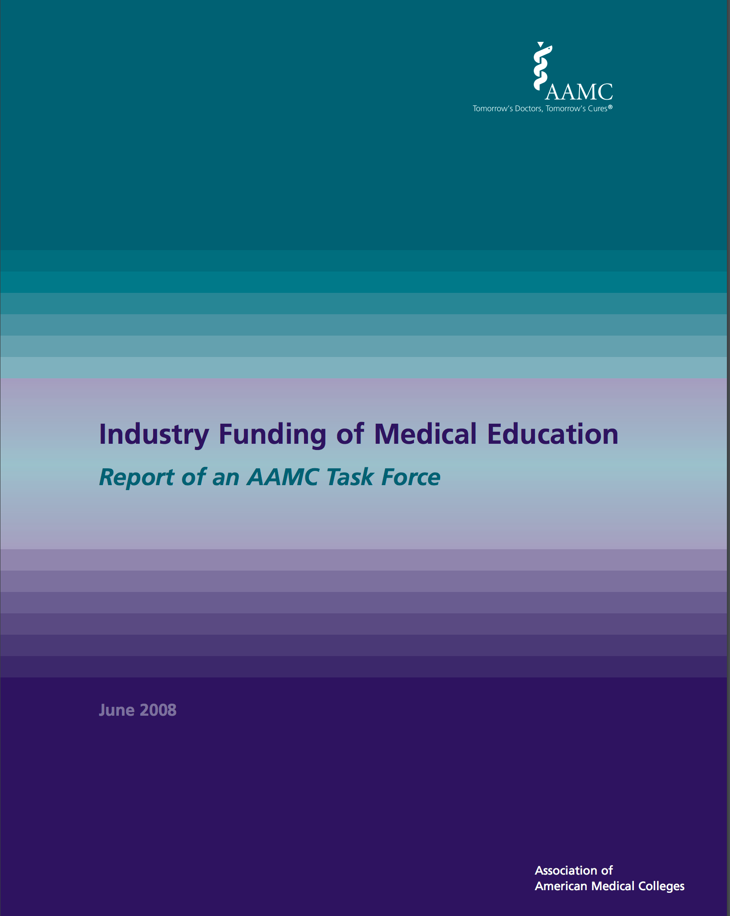
http://www.ucsfcme.com/news/IndustryFundingMedicalEduation.pdf
Notes:
endorsed by AFMC-Association of Faculties of Medicine of Canada)

Slide 23
“Interactions with Pharmaceutical Representatives Policy” Oct 30, 2015
(SMH Intranet)

Slide 25
What do we need to know about the U of T Standards?
Principles:
The interests of our patients are paramount
We are role models for trainees:
Rules apply to all of us, at all times

Slide 26
U of T Relationship with Industry & the Educational Environment in UME & PGME
Sales Representatives:
Meetings between industry product or sales representatives and students or trainees should occur only in educational settings and when a faculty member is present.
The faculty member has a responsibility to ensure that any discussion about specific products is medically and scientifically sound, balanced and includes alternatives.
\

Slide 27
U of T Relationship with Industry & the Educational Environment in UME & PGME
Student or trainee contact information must not be provided to industry representatives.

Slide 28
U of T Relationship with Industry & the Educational Environment in UME & PGME
Faculty members should consider the educational value of meeting with representatives of industry and recognize that in doing so they model such interactions for trainees.
Meetings with representatives should be by appointment.
Meetings with industry representatives should not normally take place in the presence of patients unless the representatives are specifically needed for patient care.

Slide 29
Gifts must not be accepted from industry.
This includes food and entertainment,
which are considered gifts.

Slide 30
Educational events and programs
Address the educational needs of learners
Are “Hands off” from sponsor(s)
Openly acknowledge sponsor(s)
Properly disclose potential COI
Properly display commercial information

Slide 31
Ghostwriting
When publishing as an author, faculty members
must insist that contributions written by industry
are clearly disclosed and acknowledged.

Slide 32
Food
Offering food/hospitality may be appropriate at events,
but engenders obligation and entitlement
Use of unrestricted educational grants for refreshments
- Modest food
- No reps in attendance
- Hospitality for full day programs: no direct link to the sponsor
Industry-sponsored dinner = “accepting gifts”
- Attend at your own expense!

Slide 33
Funding for Postgraduate Programs:
Unrestricted educational grant
(ideally from multiple donors)
Publically acknowledged
Managed centrally by PD or DDD
with financial statements
Donor plays no role selecting trainees for funding
No quid pro quo

Slide 34
Consultation to industry:
CAN do (with reasonable compensation and disclosure):
Teach company personnel at education sessions
Consultation for advocacy, health promotion, better products
Industry-funded public education with no brand product
CANNOT do:
Speaker’s bureau (paid to give company talks)
Participate in industry sales program/ marketing

Slide 35
Drug Samples:
Ideally with central depository and pharmacists
Not used by doctors or their families
Proper records, storage, dispensing
Declare COI if on hospital drug/devices selection
committee

Slide 36
Disclosure
What to disclose: Salary support, consultancy fees,
honoraria, research support, ownership interest,
financial interest (not amounts)
When to disclose:
At all lectures/seminars, held anywhere
All manuscripts submitted for publication
Consulting to government, public or private agencies
Interacting with the media

Slide 37
Questions?

