Slide 1
Expectations of Academic Clinical Faculty Teaching and Education
Martin Schreiber
Professor
Chair, Teaching Effectiveness Committee

Slide 2
Outline
Why teach?
What kinds of teaching opportunities are there?
What are you expected to do?
How to document effectiveness?
How to get better?

Slide 3
Why teach?
Because it is a great thing to do
Because it is a really important thing to do well
Because it is expected of all academic physicians
Because we receive remuneration for it

Slide 4
Why teach?
Because it is a great thing to do
Because it is a really important thing to do well
Because it is expected of all academic physicians
Because we receive remuneration for it

Slide 5
Why teach?
Because it is a great thing to do
Because it is a really important thing to do well
Because it is expected of all academic physicians
Because we receive remuneration for it

Slide 6
The importance of teaching and assessing well
Obviously – these are the doctors of tomorrow
Must be taught well
Must be assessed properly
Formative
Summative

Slide 7
Why teach?
Because it is a great thing to do
Because it is a really important thing to do well
Because it is expected of all academic physicians
Because we receive remuneration for it

Slide 8
Why teach?
Because it is a great thing to do
Because it is a really important thing to do well
Because it is expected of all academic physicians
Because we receive remuneration for it

Slide 9
Outline
Why teach?
What kinds of teaching opportunities are there?
What are you expected to do?
How to document effectiveness?
How to get better?

Slide 10
What kinds of teaching opportunities are there? (1 of 3)
Familiar teaching roles
UG
Lectures, seminars, case-based learning
Bedside
Clerkship clinical supervision
PG
Clinical supervision
Didactic teaching (morning report, noon rounds, etc.)
CE

Slide 11
What kinds of teaching opportunities are there? (1 of 3)
Familiar teaching roles
UG
Lectures, seminars, case-based learning
Bedside
Clerkship clinical supervision
PG
Clinical supervision
Didactic teaching (morning report, noon rounds, etc.)
CE

Slide 12
What kinds of teaching opportunities are there? (1 of 3)
Familiar teaching roles
UG
Lectures, seminars, case-based learning
Bedside
Clerkship clinical supervision
PG
Clinical supervision
Didactic teaching (morning report, noon rounds, etc.)
CE

Slide 13
What kinds of teaching opportunities are there? (2 of 3 )
Less familiar roles
Teaching outside Faculty of Medicine
Patient education
Taking part in assessment (e.g. OSCE examiner)
Research supervision
Supervision of QI projects
Mentorship

Slide 14
What kinds of “teaching” opportunities are there? (3 of 3)
Education scholarship
Curriculum development
Novel teaching methods
Educational research
Education administration
UG
Course director, site director
PG
Site director, program director
Committees
Admission
Faculty development

Slide 15
Outline
Why teach?
What kinds of teaching opportunities are there?
What are you expected to do?
How to document effectiveness?
How to get better?

Slide 16
What are you expected to do?
Well, it depends….
http://www.deptmedicine.utoronto.ca/academic-position-descriptions

Slide 17
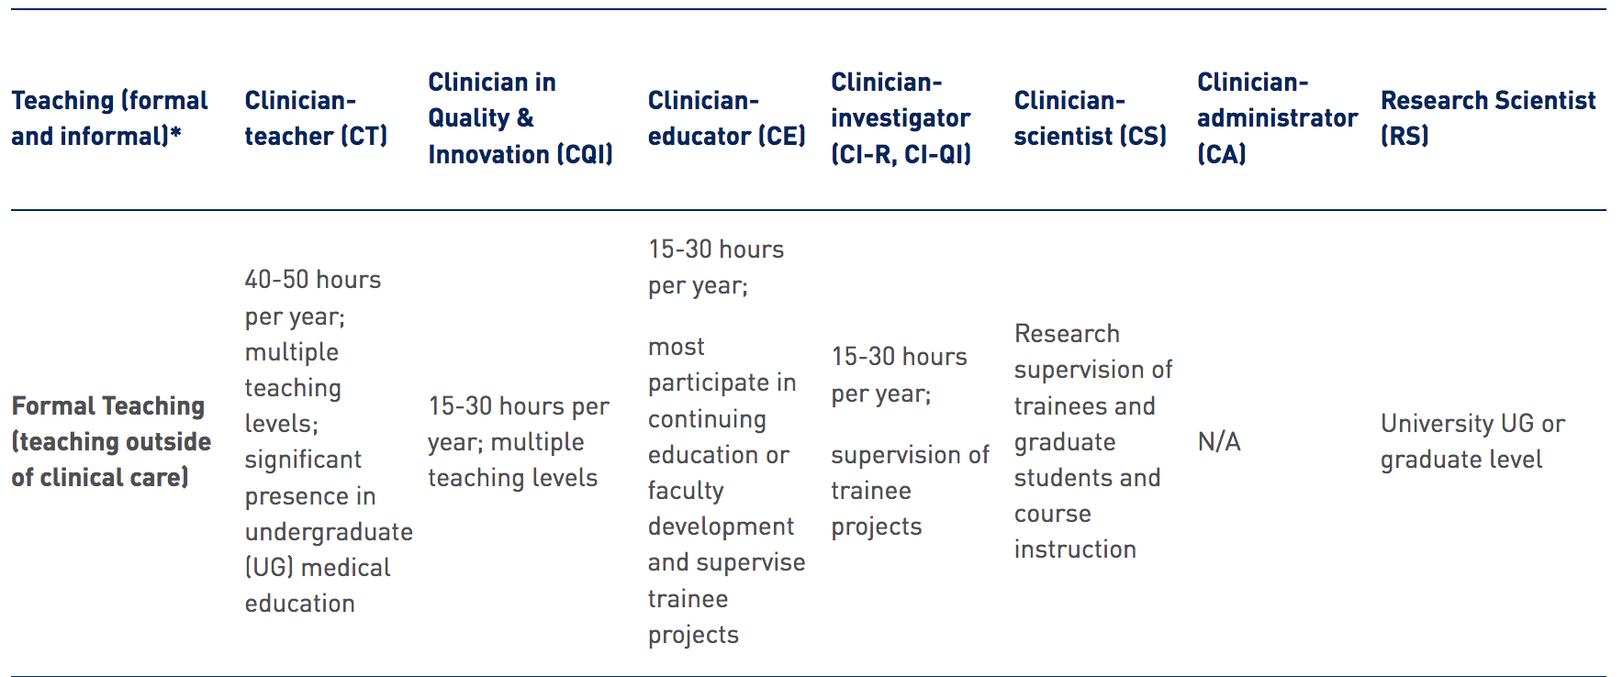
Formal teaching expectations

Slide 18
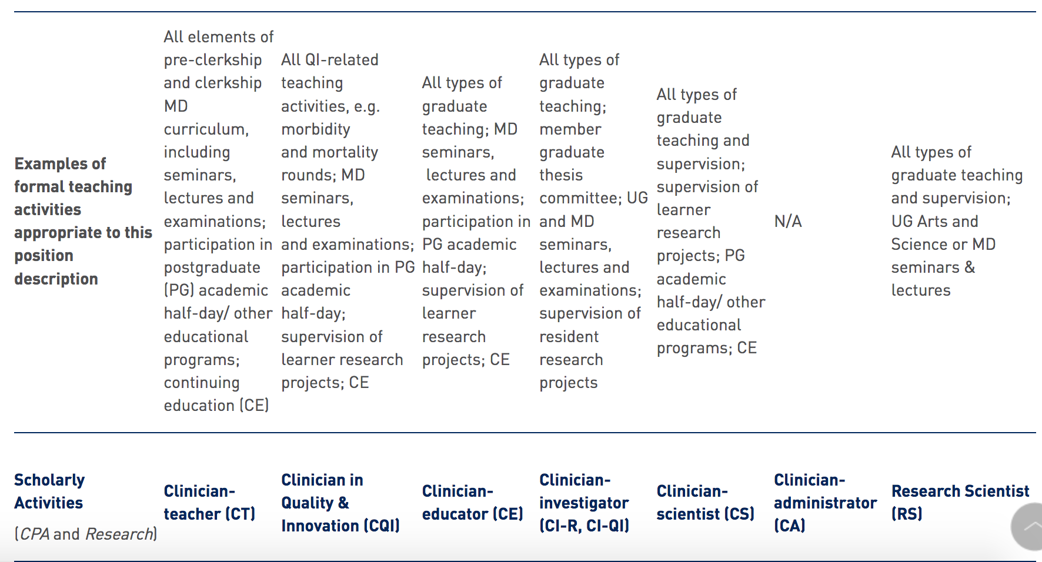
Examples of teaching activities

Slide 19
Outline
Why teach?
What kinds of teaching opportunities are there?
What are you expected to do?
How to document effectiveness?
How to get better?

Slide 20
How to document effectiveness (What is teaching effectiveness committee interested in?)
Parameter | Comments
Quantity | Keep track of what you do!
Quality | Make sure you get your evaluations
Scholarship in teaching | Many things count!
Leadership in teaching | Many things count!
For most faculty members – competence is required
For those whose promotion is based on excellence in teaching – well, excellence is goal!

Slide 21
Outline
Why teach?
What kinds of teaching opportunities are there?
What are you expected to do?
How to document effectiveness?
How to get better?

Slide 22
How to get better? How to get help?
Faculty development
UG – Office of Faculty Development
http://ofd.med.utoronto.ca/
Other – Faculty of Medicine Centre for Faculty Development
https://cfd.utoronto.ca/
Appealing evaluations (prospective and retrospective!!)
Contact Ed Lorens (ed.lorens@utoronto.ca)
Master Teacher Program
Other resources – see handout!!

